Slide 1
Simultaneous dimension reduction and clustering via the NMF-EM algorithm
GwangWoo Kim
September 14, 2021

Slide 2
Content
Introduction and Preliminary
The NMF-EM algorithm
Simulation study
Application to ticketing data
References

Slide 3
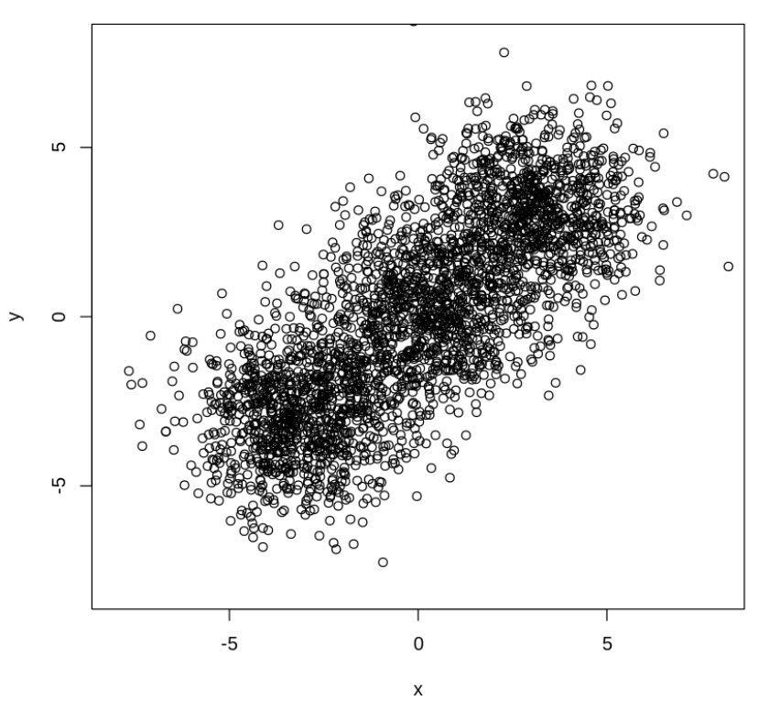
1. Introduction and Preliminary

Slide 4
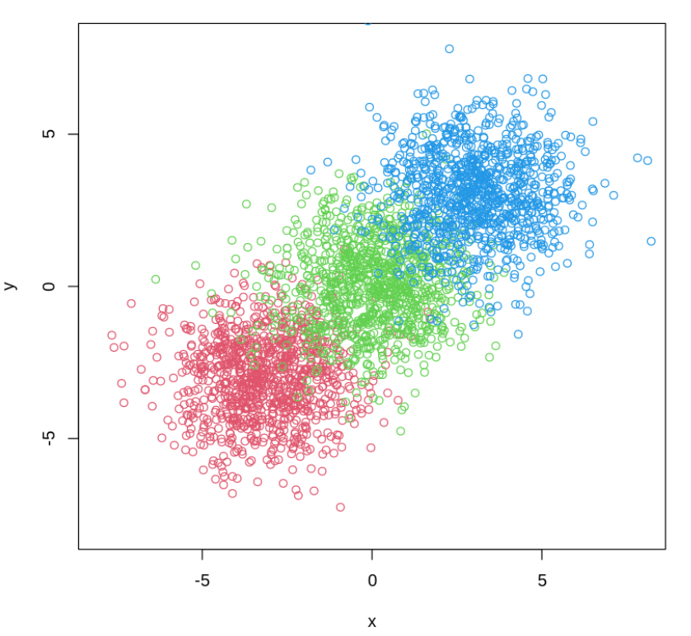
1. Introduction and Preliminary

Slide 5
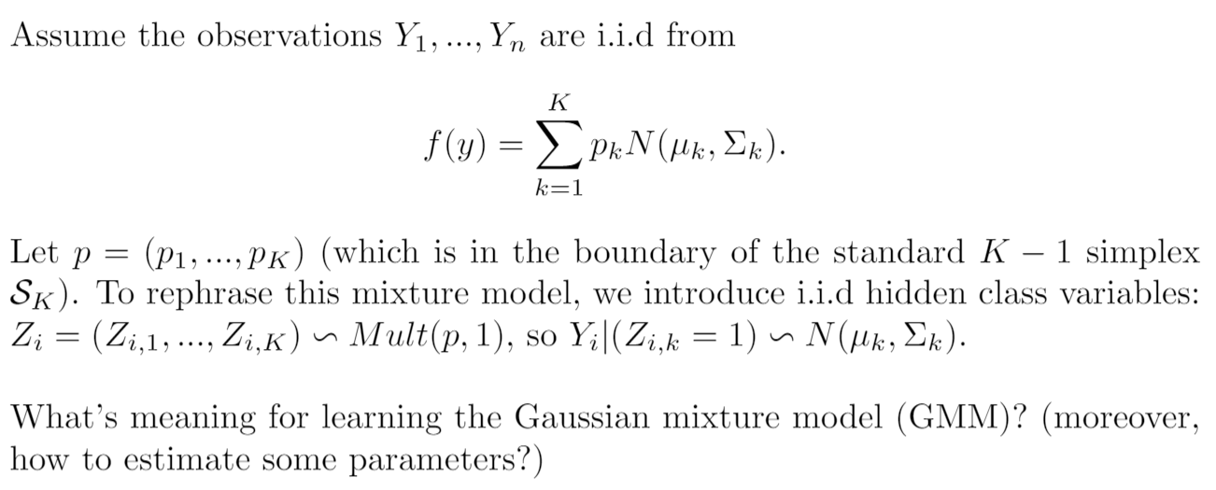
1. Introduction and Preliminary

Slide 6
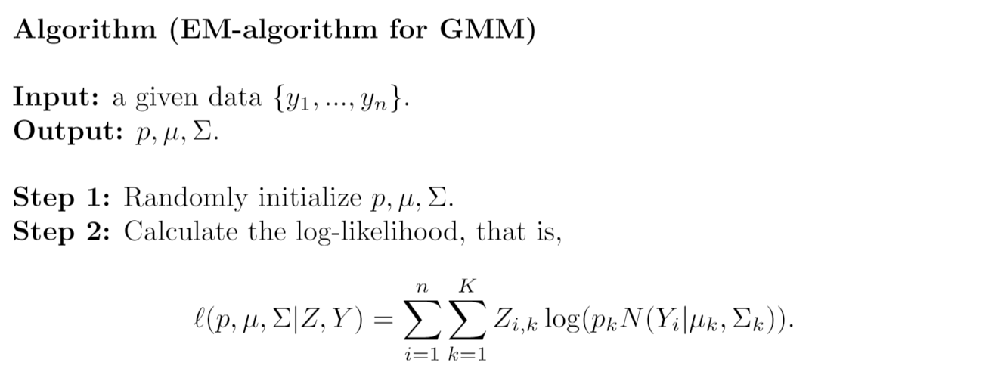
1. Introduction and Preliminary

Slide 7
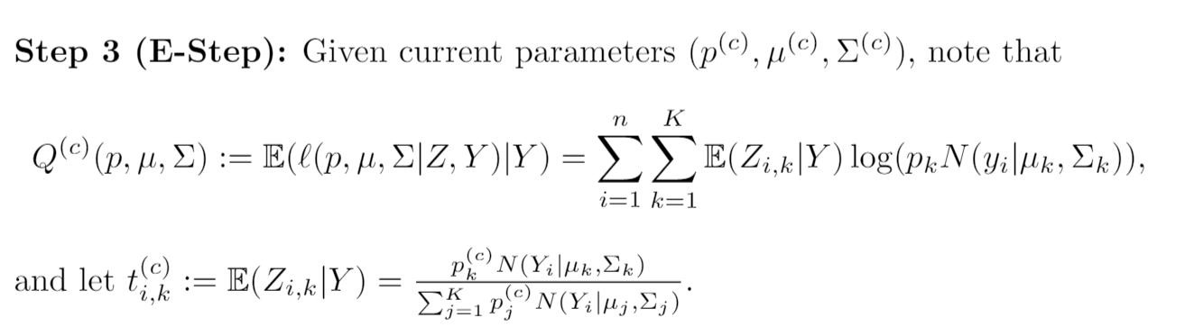
1. Introduction and Preliminary

Slide 8
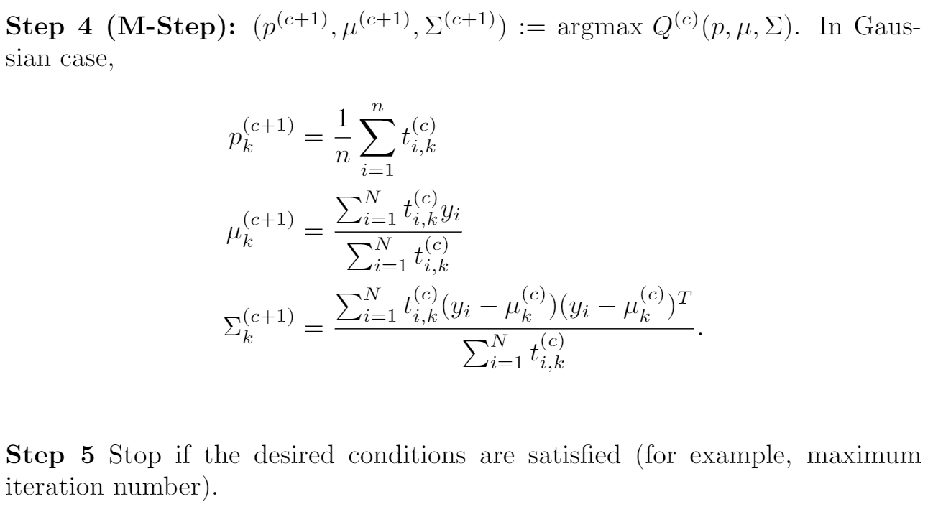
1. Introduction and Preliminary

Slide 9
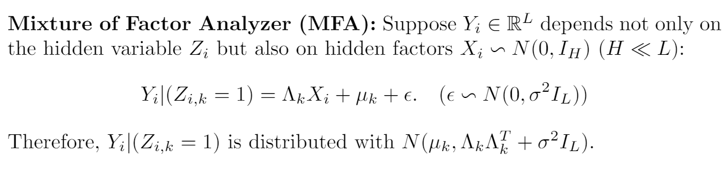
1. Introduction and Preliminary

Slide 10
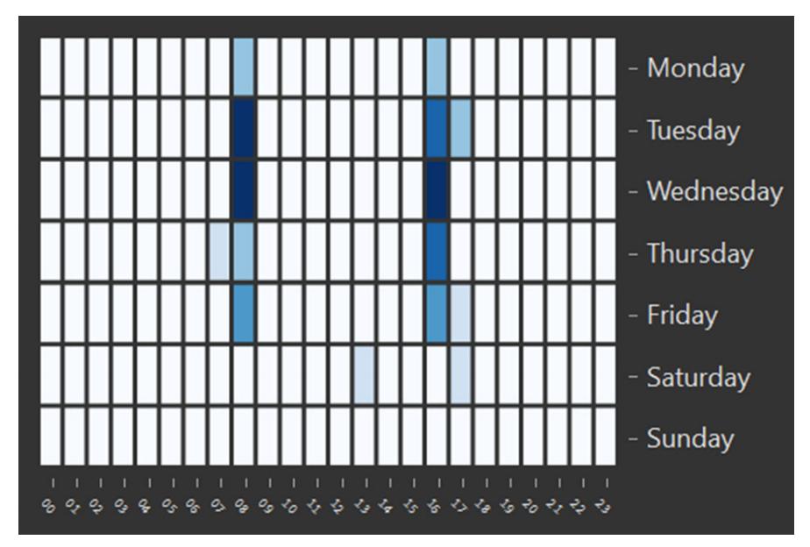
1. Introduction and Preliminary

Slide 11
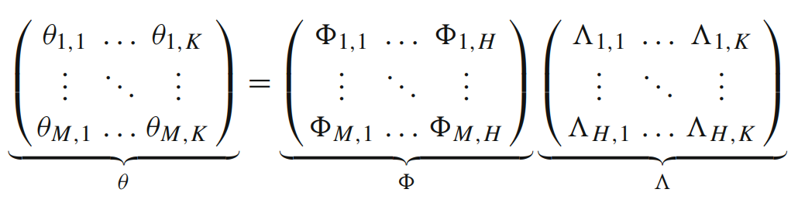
1. Introduction and Preliminary

Slide 12
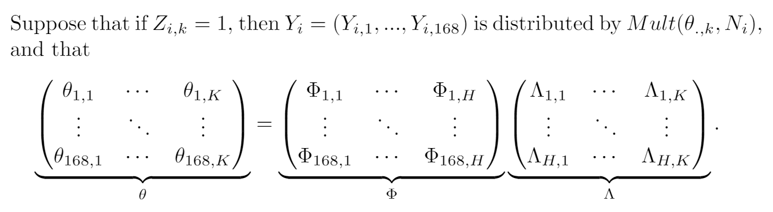
2. The NMF-EM algorithm

Slide 13
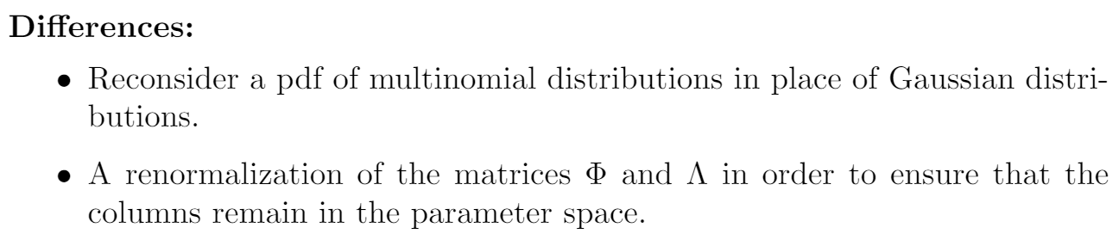
2. The NMF-EM algorithm

Slide 14
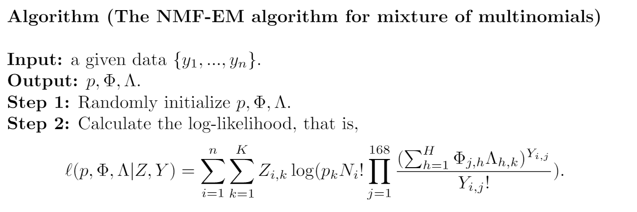
2. The NMF-EM algorithm

Slide 15
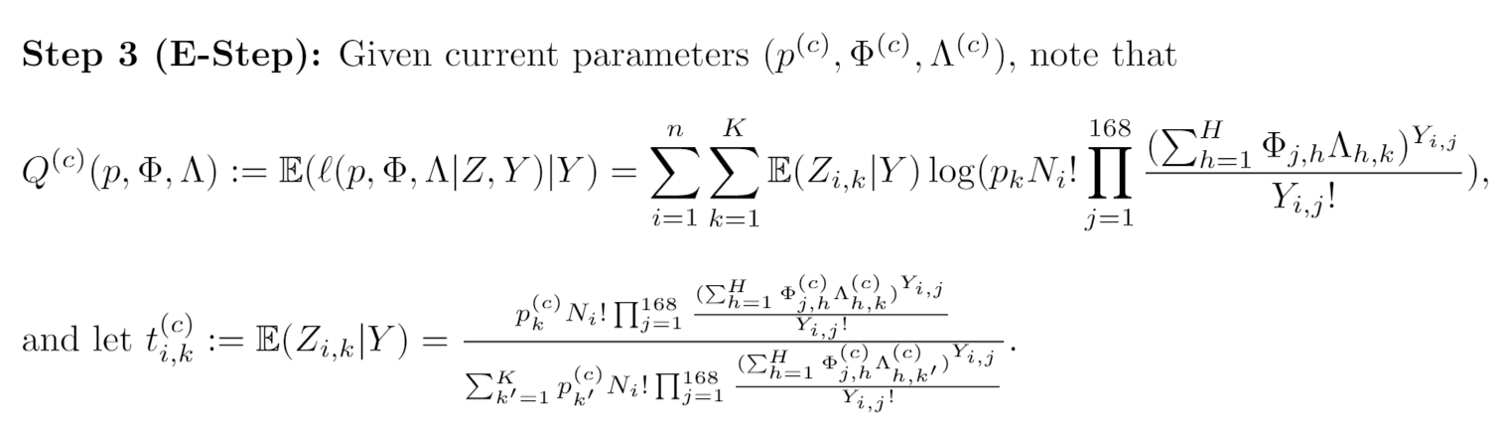
2. The NMF-EM algorithm

Slide 16
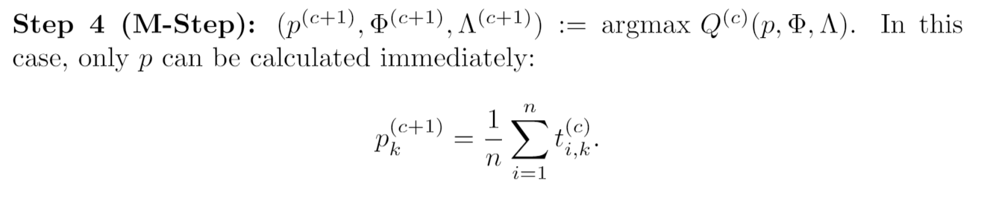
2. The NMF-EM algorithm

Slide 17
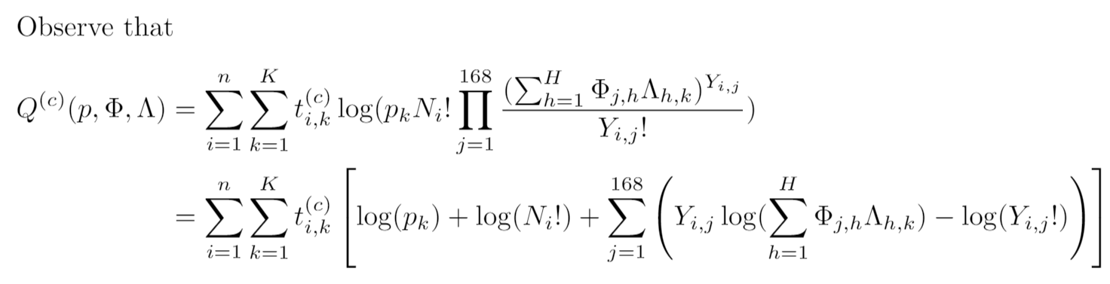
2. The NMF-EM algorithm

Slide 18
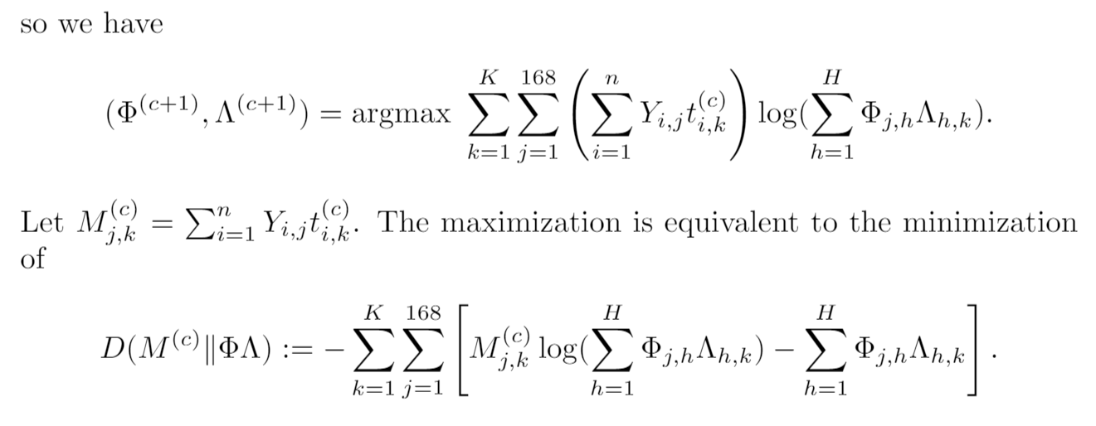
2. The NMF-EM algorithm

Slide 19
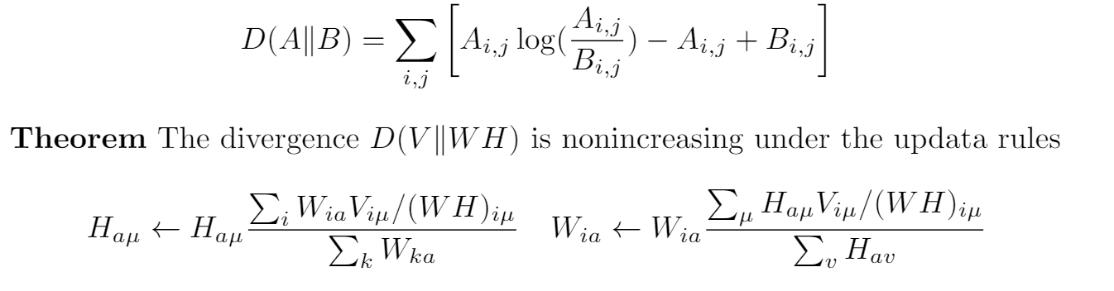
2. The NMF-EM algorithm

Slide 20
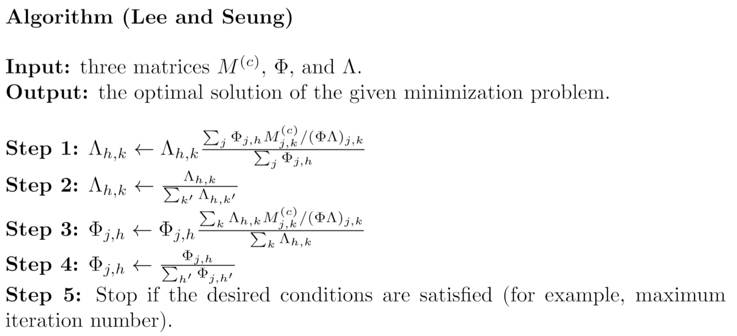
2. The NMF-EM algorithm

Slide 21
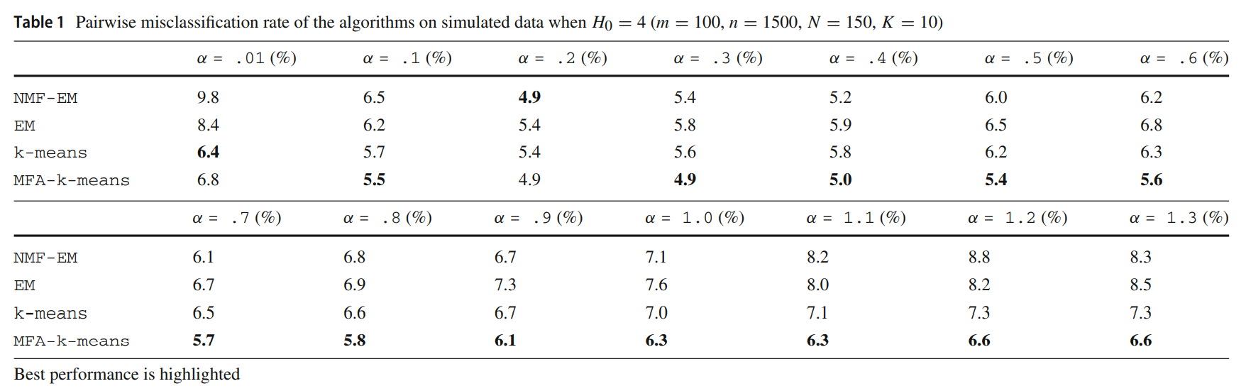
3. Simulation study

Slide 22
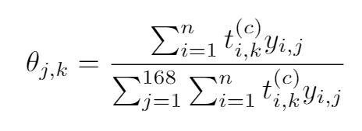
3. Simulation study

Slide 23
4. Application to ticketing data

Slide 24
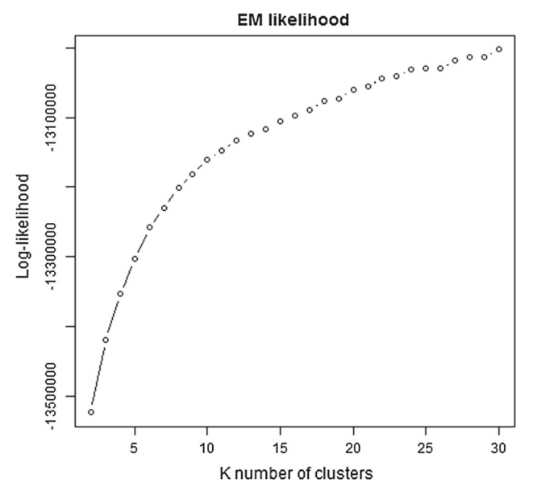
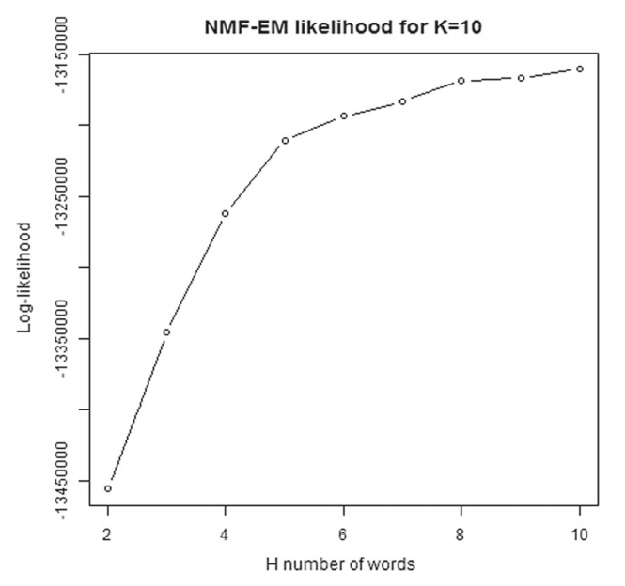
4. Application to ticketing data

Slide 25
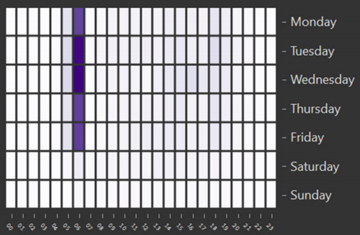
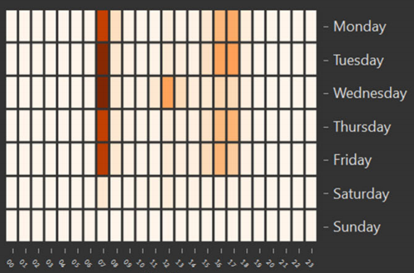
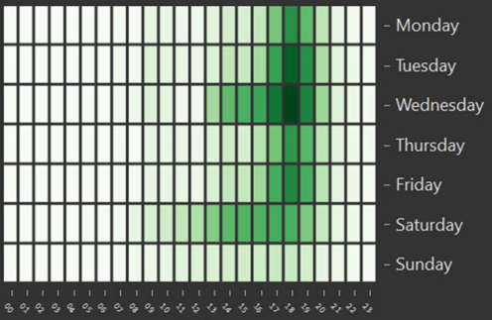
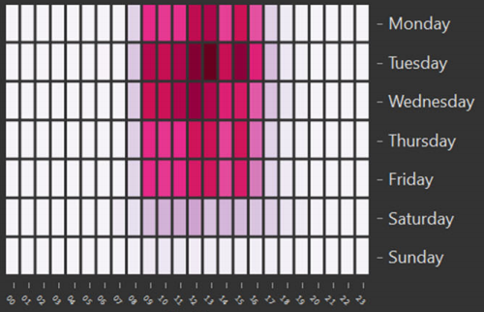
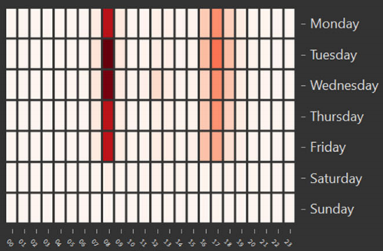
4. Application to ticketing data

Slide 26
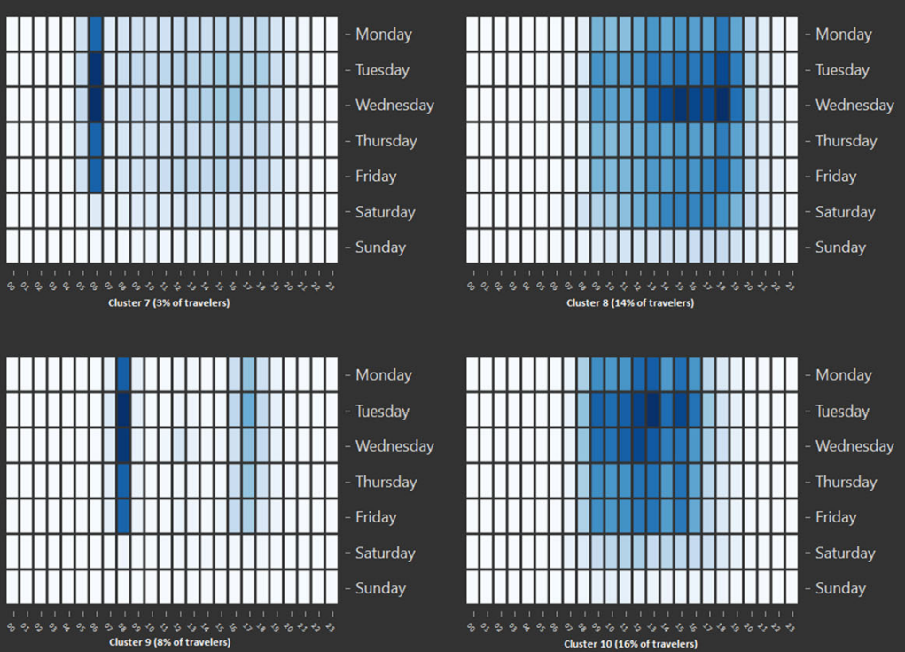

Slide 27
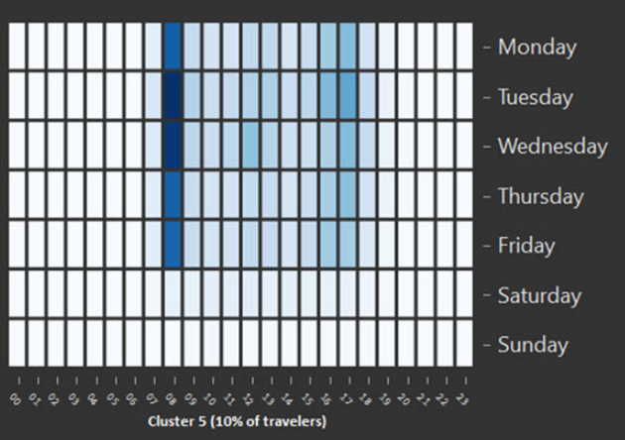
4. Application to ticketing data
47%
48%

Slide 28
5. References
[1] Carel, L., & Alquier, P. (2021). Simultaneous dimension reduction and clustering via the NMF-EM algorithm. Advances in Data Analysis and Classification, 15, 231-260.
[2] Lee, D. D., & Seung, H. S. (1999). Learning the parts of objects by non-negative matrix factorization. Nature, 401(6755), 788-791.
[3] Stats 306B: Methods for Applied Statistics: Unsupervised Learning Lester Mackey, Stanford University, Spring 2014.

